Slide 1
Problem Overview
Our project addresses the inefficiencies found in traditional Variable Frequency Drives (VFDs) by designing a more efficient three-phase matrix converter. VFDs are crucial in controlling the speed of AC motors by adjusting the frequency of the AC input voltage, making them essential in various industries such as manufacturing, HVAC systems, and more. However, conventional VFDs employ an AC-DC-AC conversion process which introduces inefficiencies and increased part count. Our design implements direct AC-AC conversion, which removes the need of additional components, including electrolytic energy storage, and in turn increases efficiency of the output power.

Slide 2
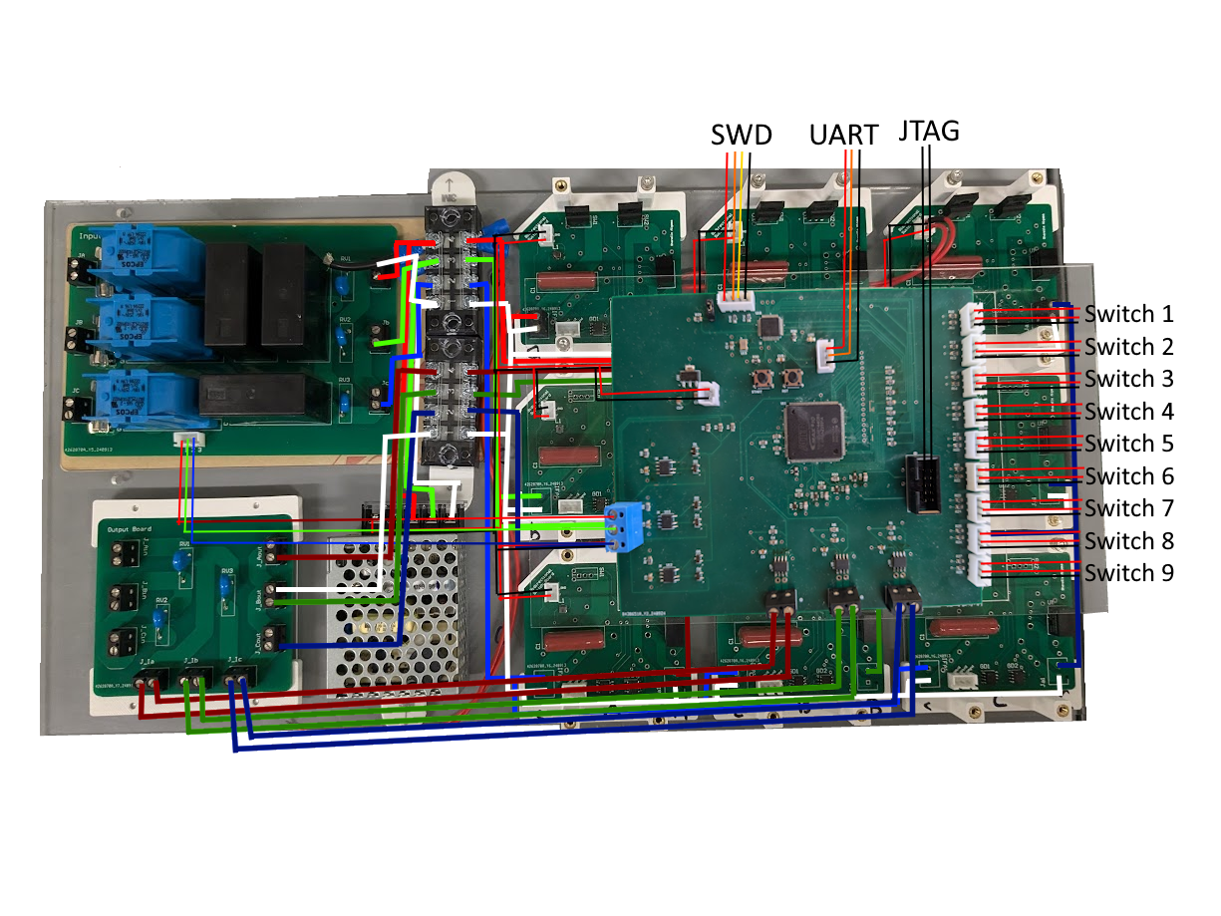
Integrated Project Diagram
Notes:
TODO HAVE EVERYONE ELSE LOOK AT

Slide 3
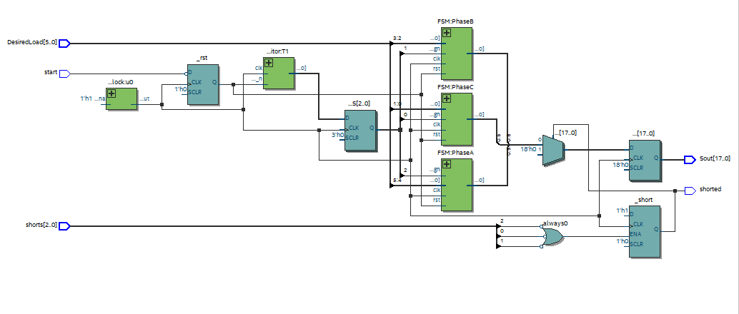
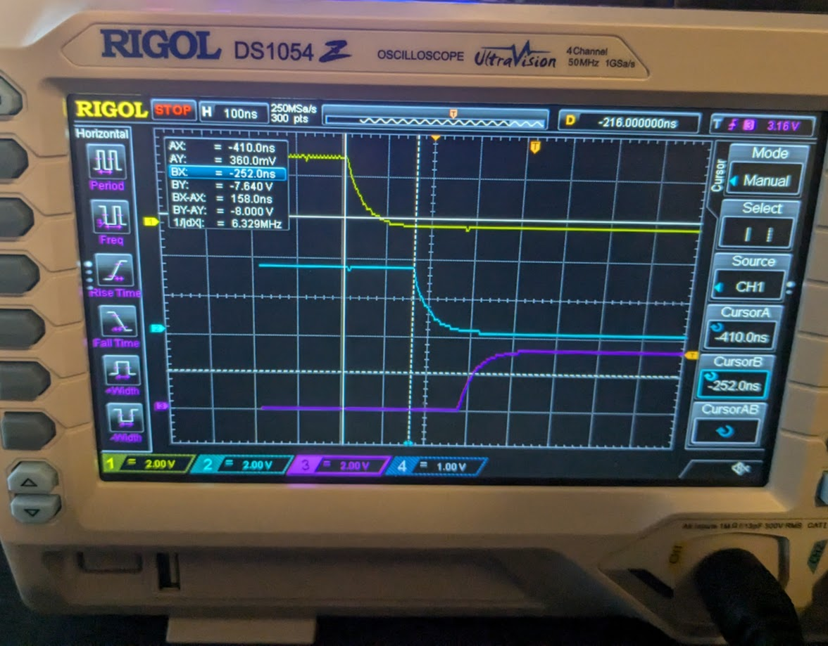
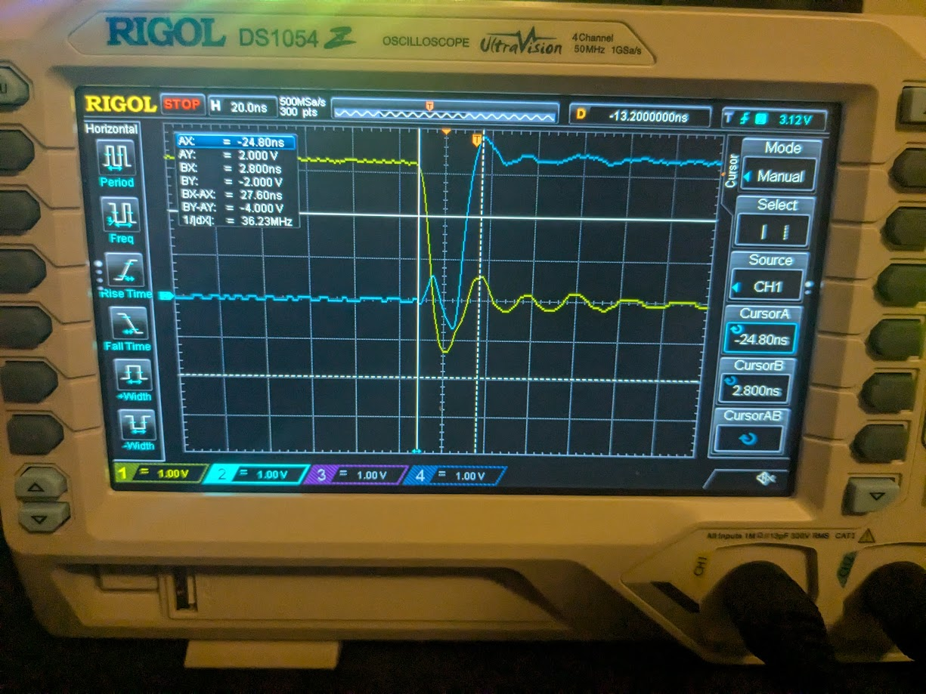
Chase Barnes
FPGA Firmware
FPGA Timing Req. | Requirements | FPGA Results
TDon | >19ns | 118ns
TDoff | >100ns | 158ns
Shorting | <6us | 28ns
TD on and TD off timing for 3 Pins
Simulated Short Timing
Notes:
FPGA Appropriately Communicates with Microcontroller to produce the correct output Switch, with appropriate Safe Commutation Setup for Bidirectional Switches

Slide 4
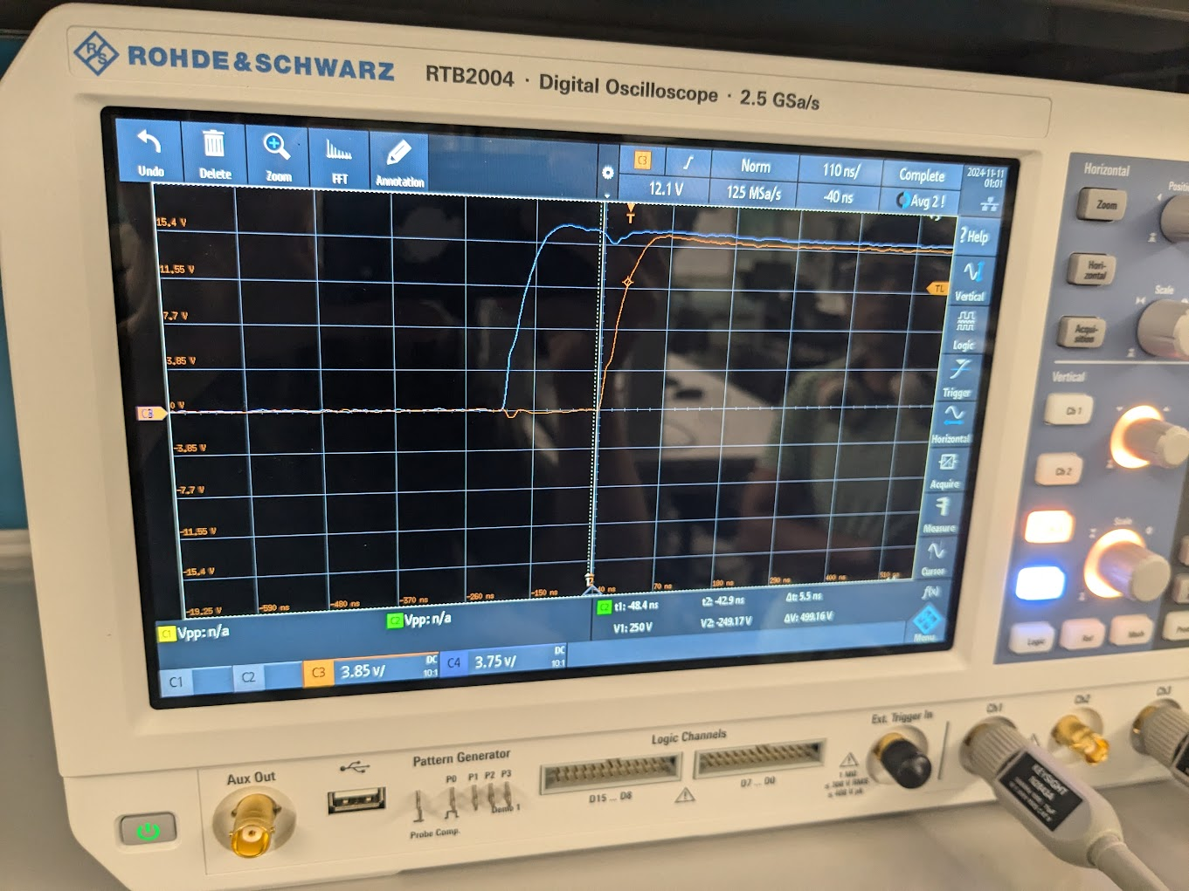
Chase Barnes
FPGA Bidirectional Switch Communication
Gate Driver | Requirements | Gate Driver
Td rise | 50ns | 54ns
TD on | >19ns | 126ns
TD off | <200ns | 162ns
Voltage Rise | >12V | 15.5 Volts
Bidirectional Switch Gate Driver Output From FPGA
Notes:
FPGA Appropriately Communicates with Microcontroller to produce the correct output Switch, with appropriate Safe Commutation Setup for Bidirectional Switches

Slide 5
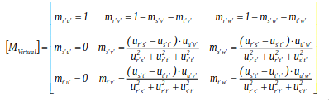
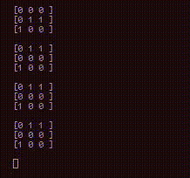
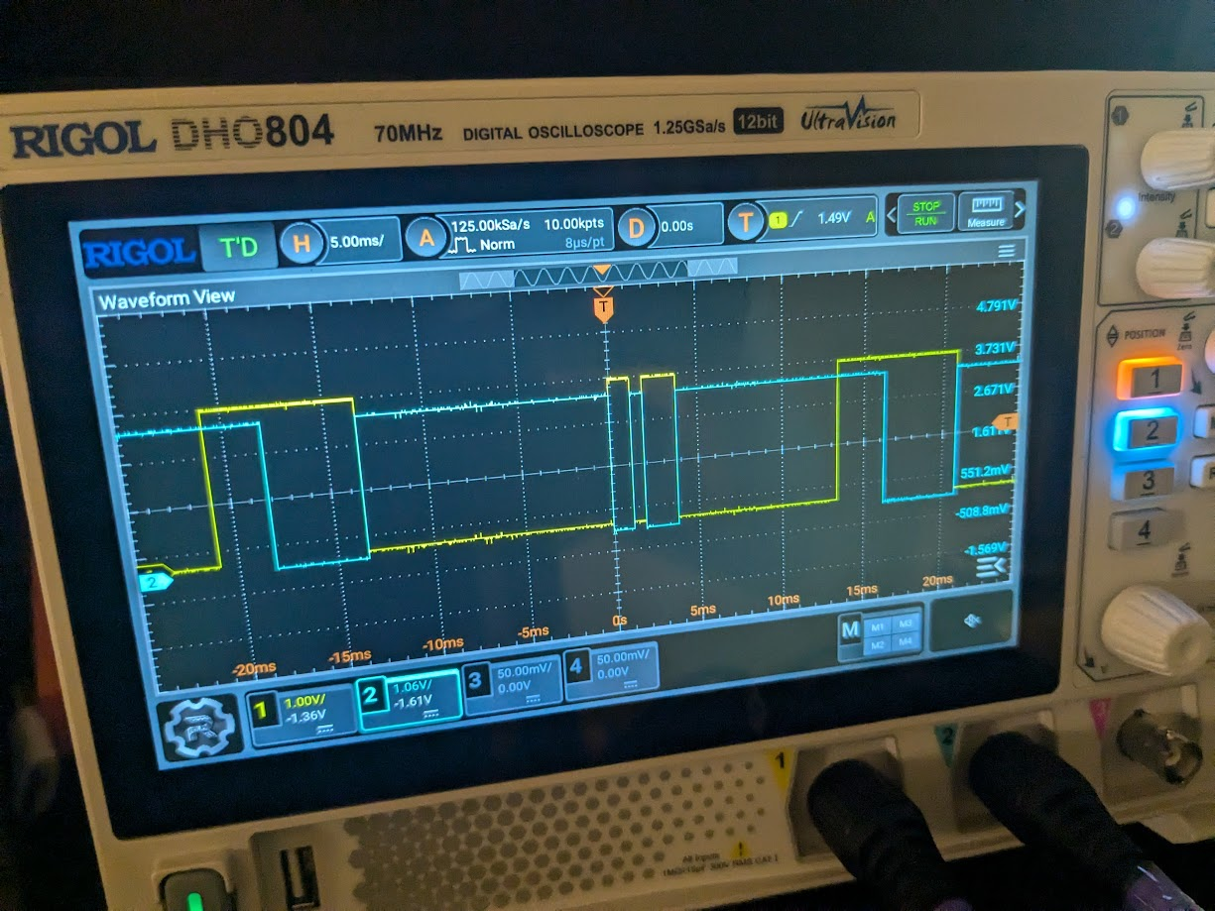
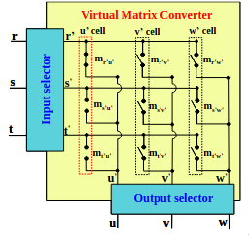
Chase Barnes
Microcontroller Firmware
Internal Microcontroller Math for Space Vector Modulation
Async Communication for Frequency
MC Output to FPGA For A Phase
Internal Virtualization of Matrix Converter

Slide 6
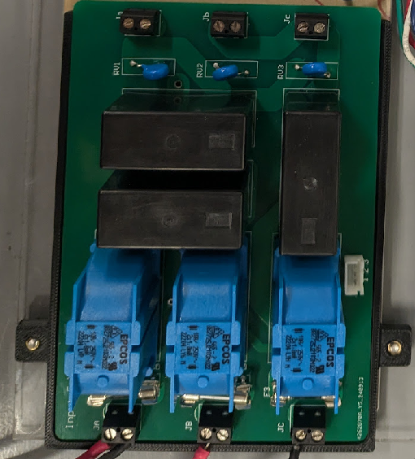
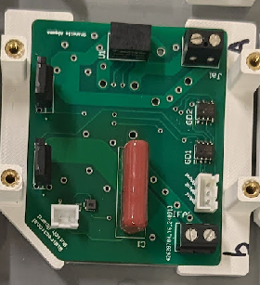
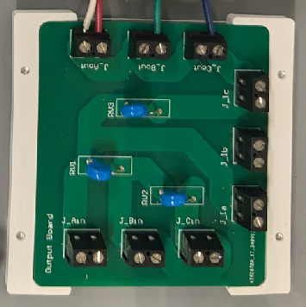
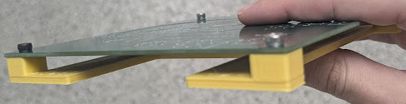
Chase Barnes
3D Printed Mounts
Input Filter Mount
Output Filter Mount
Bidirectional Switch Mount
Pulse Generator Mount

Slide 7
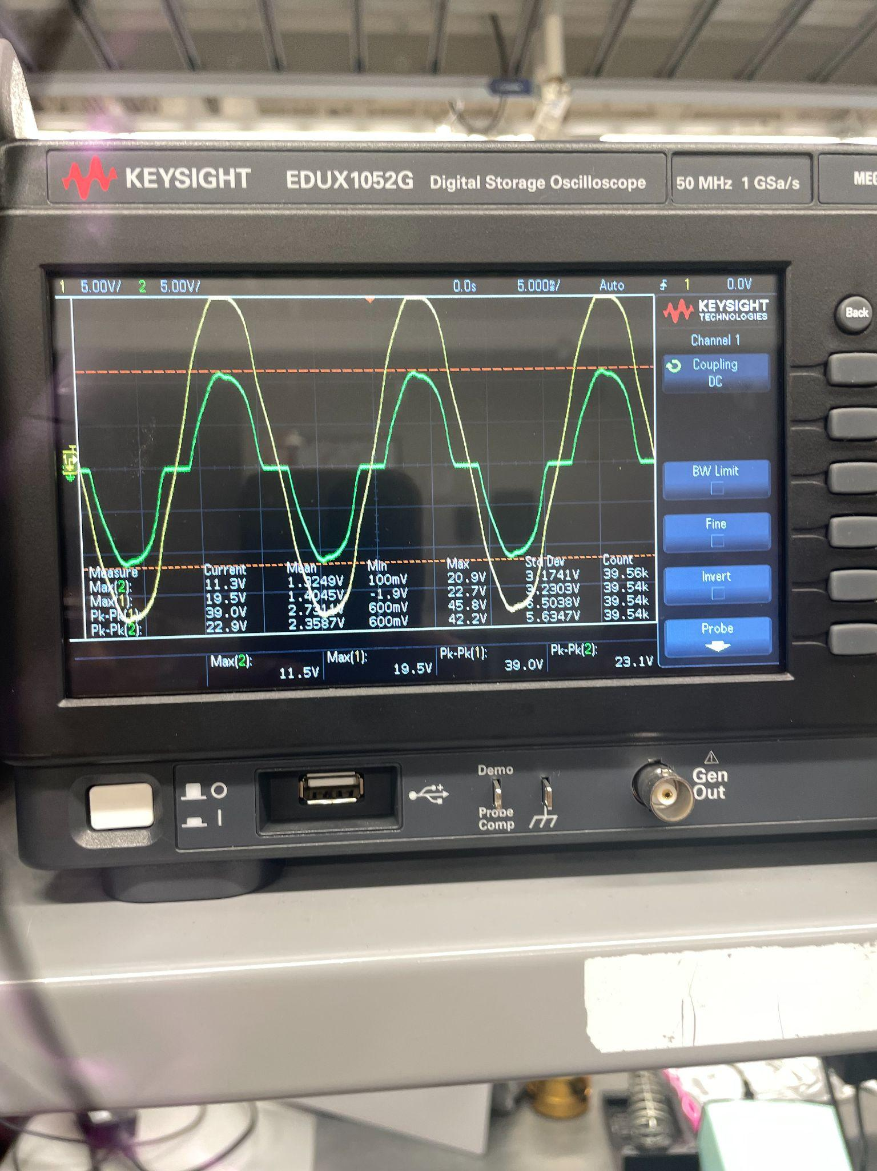
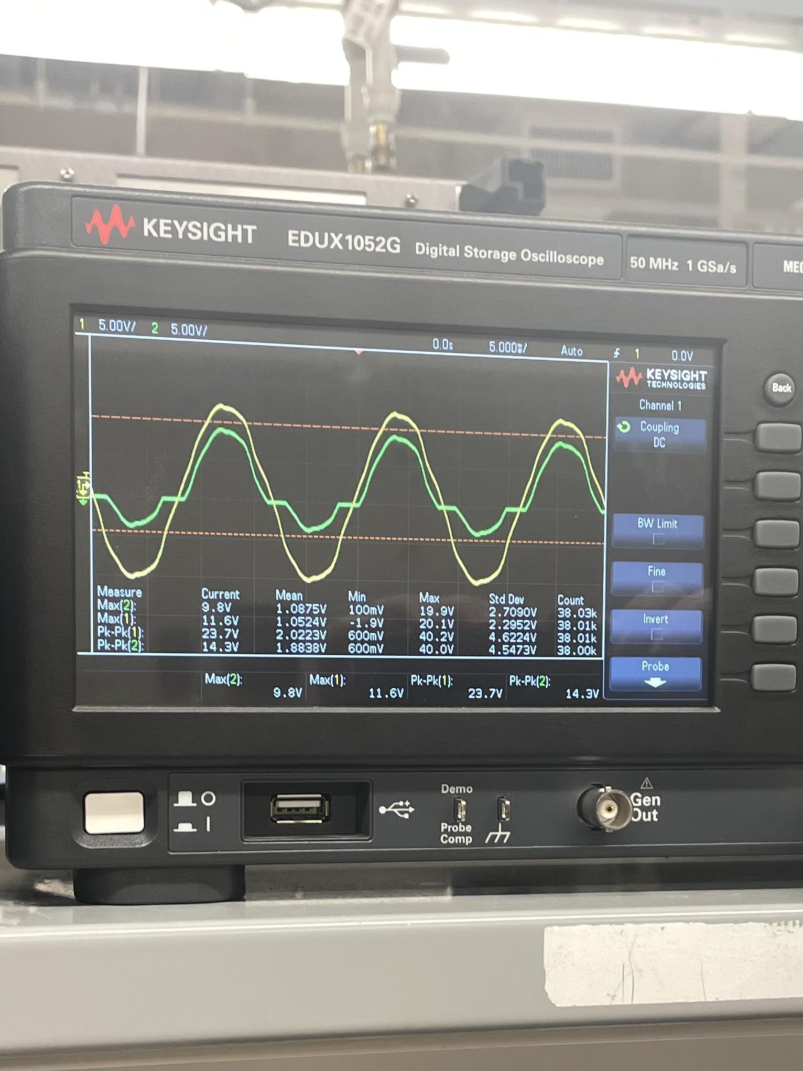
Shanelle Algama
Validated Functional Bidirectional Switch when either gate driver or both gate drivers are on, VARIAC Tested up to 39Vpp

Slide 8
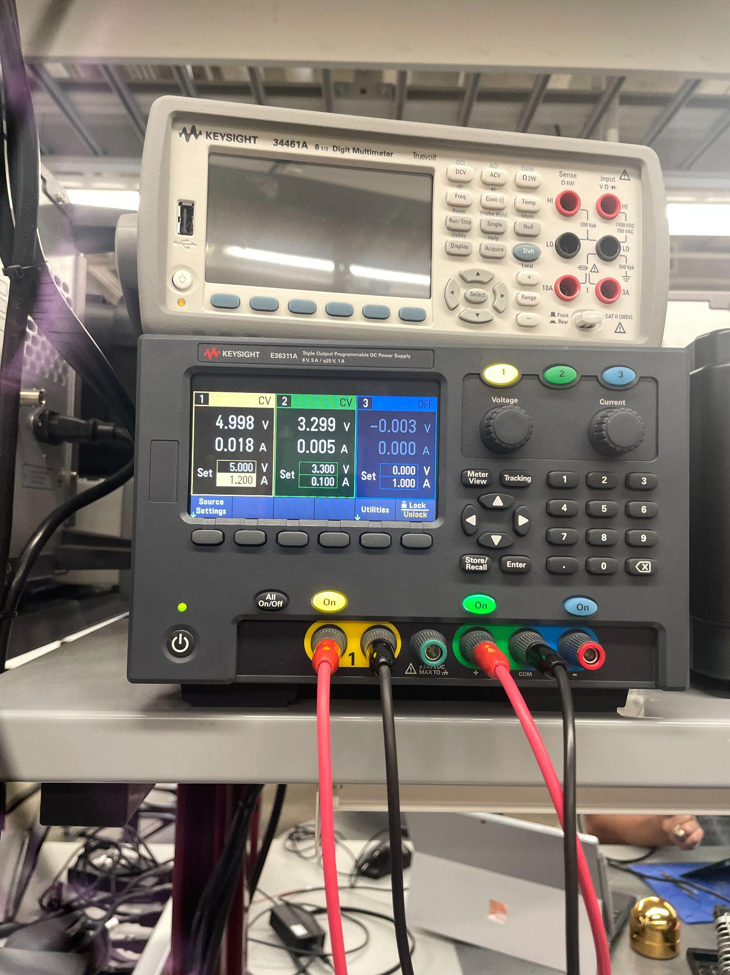
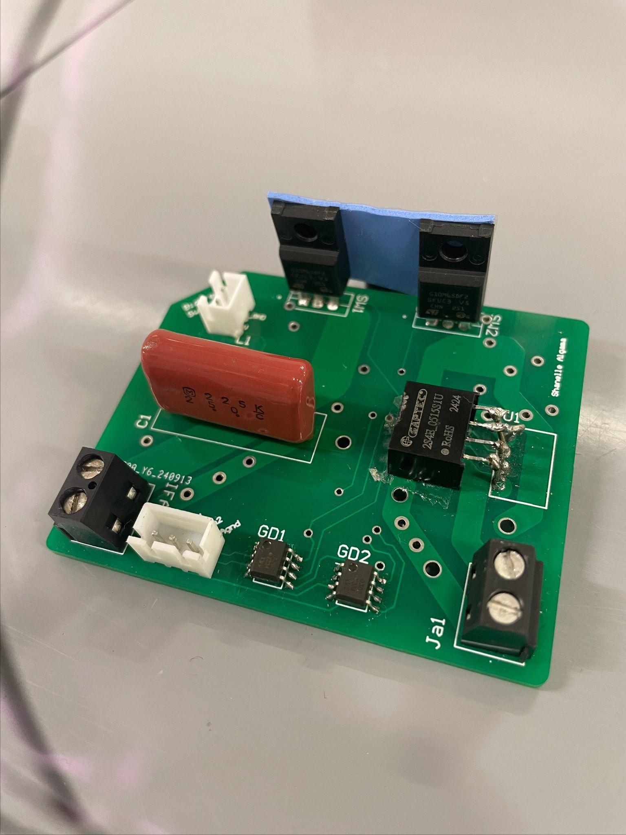
Shanelle Algama
Correct Current Draw from 5V Power Supply and 3.3V FPGA inputs to Gate Drivers
Completed and validated single Bidirectional Switch

Slide 9
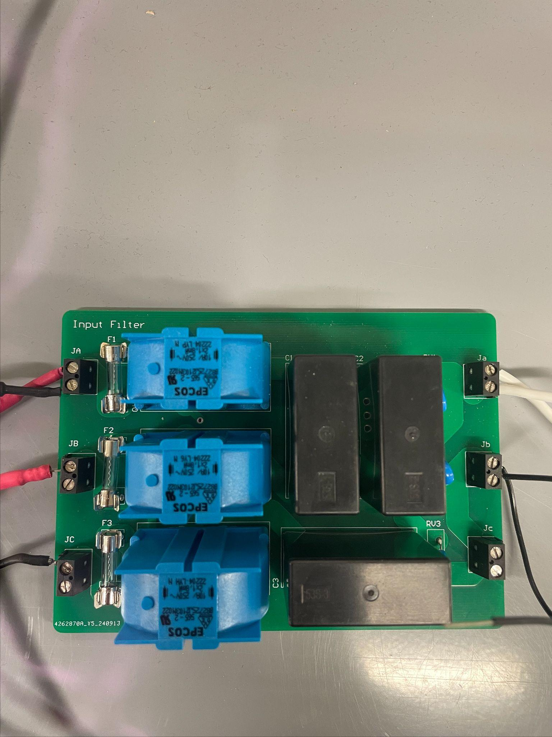
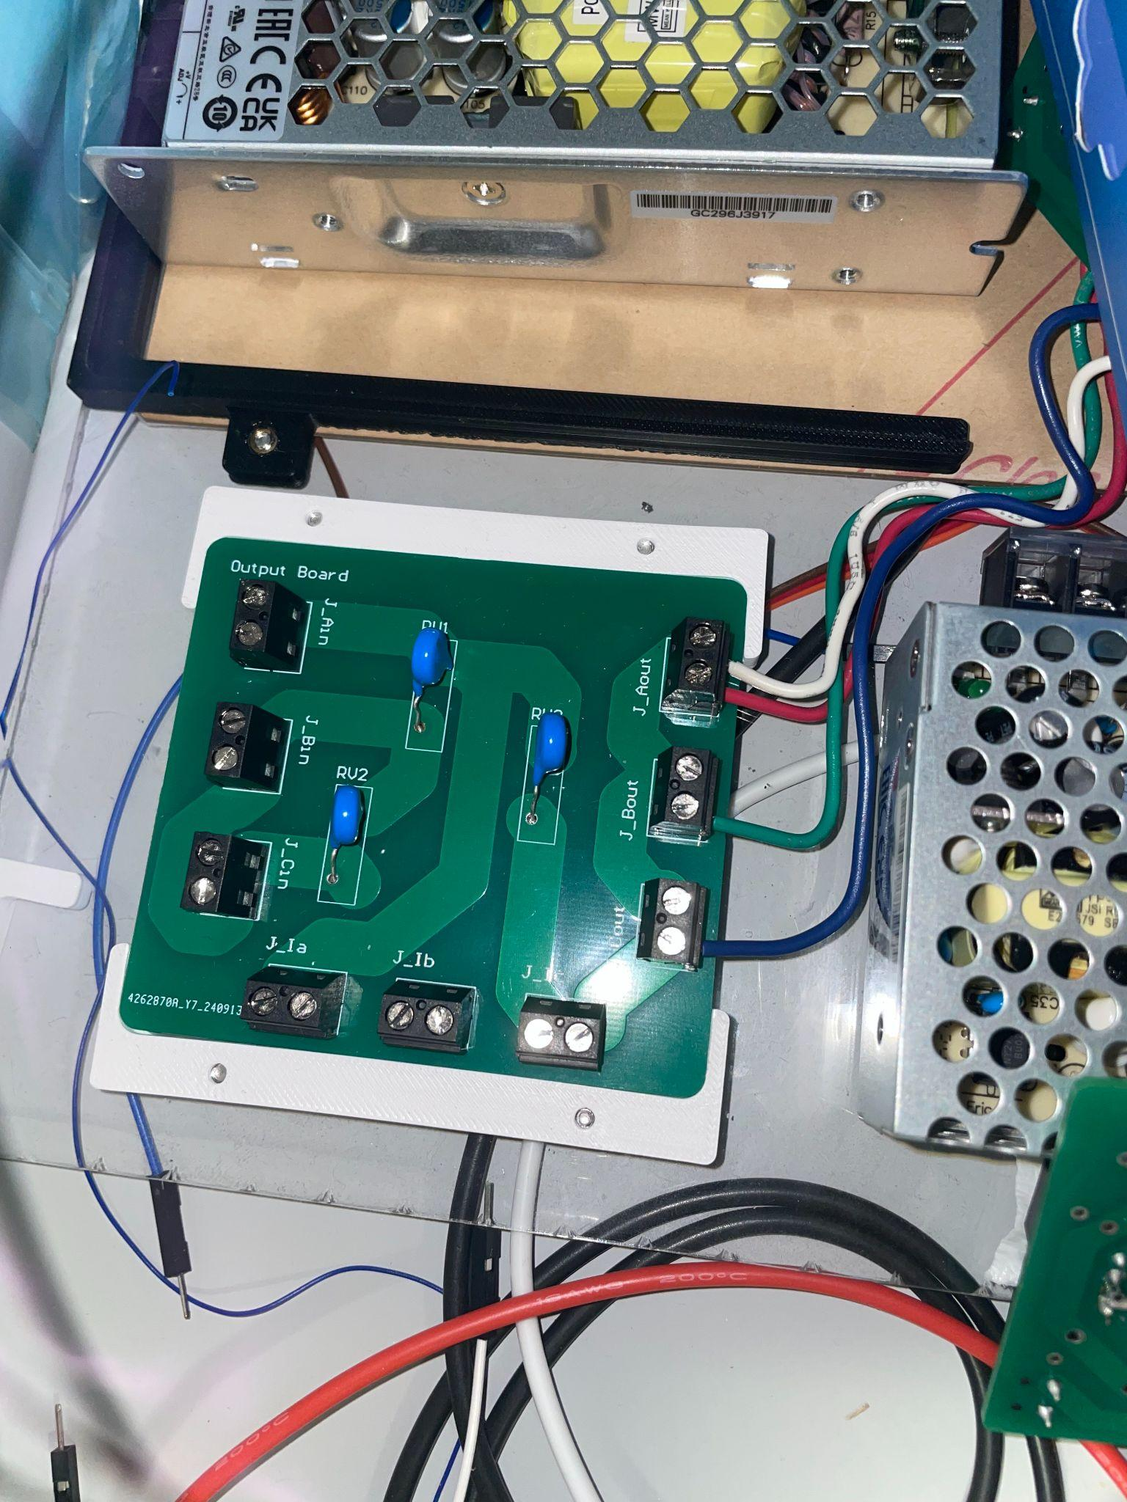
Shanelle Algama
Validated Input Filter and Output Filter Boards

Slide 10
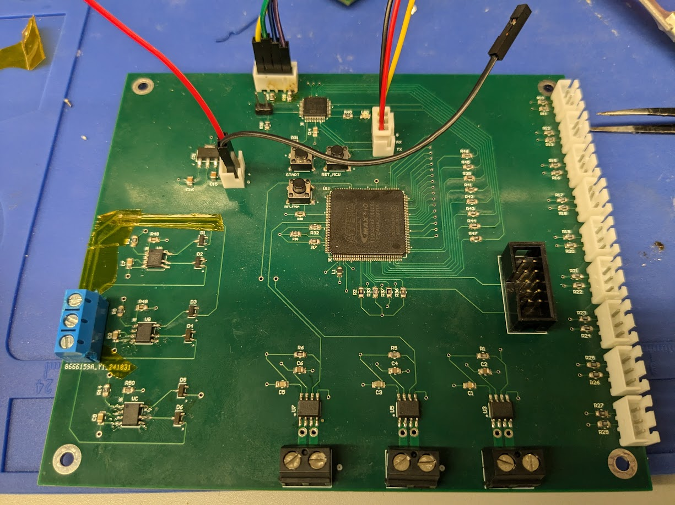
Daniel Loeza
Final PCB Design

Slide 11
Daniel Loeza
MCU Flashing
MCU
UART Communication
Voltage Regulator Input
FPGA Output to Matrix Converter
FPGA
FPGA Flashing
Zero Crossing Section
Current Sensor Section

Slide 12
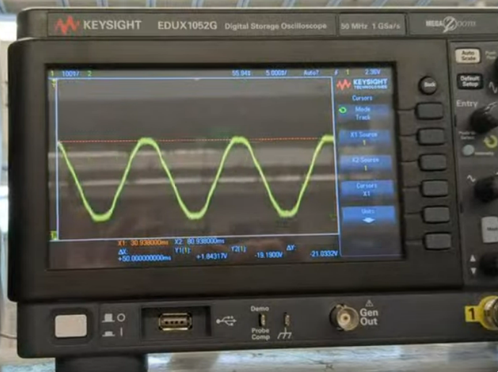
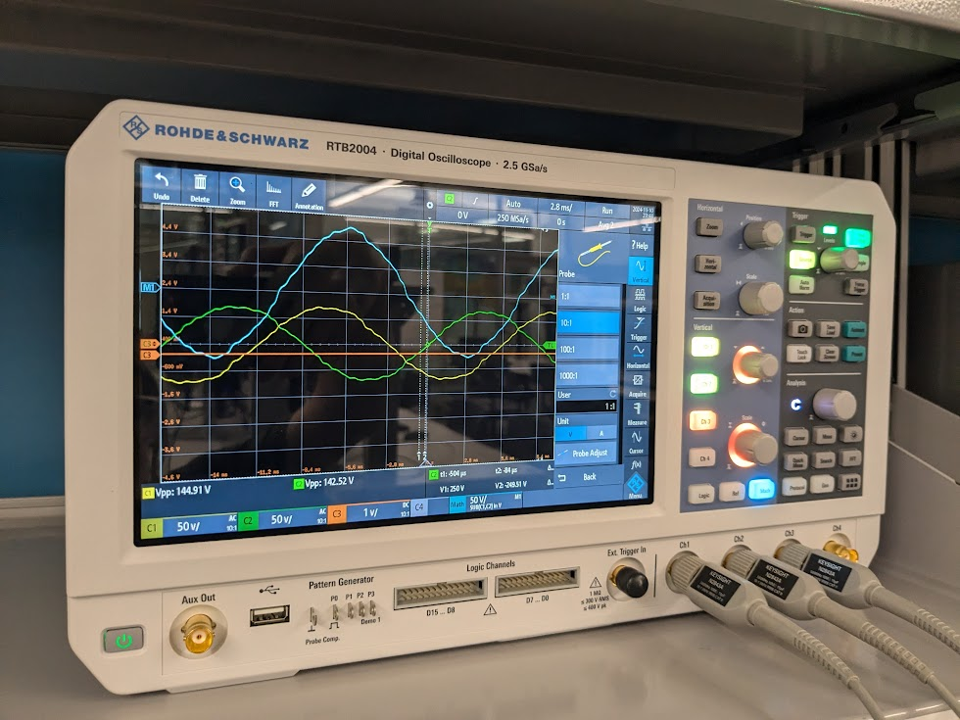
Daniel Loeza
Left: Output of the Current Sensor. 100W, 3Ω Power Resistor used.
Right: Inputs of Zero Crossing Sensor;
Green and Yellow are Phases A and B, Blue is A - B.

Slide 13
Integrated System Results
End to End Scenarios have not yet been completed due to issues with Voltage Crossing and Bidirectional Switch Issues

Slide 14
Conclusions
Originally planned to regulate 15V to 3.3V. Changed to 5V regulated to 3.3V.
Current status: Full system integration and validation to be completed by demo.

